Slide 1
Early Pregnancy Complications
Dr. Thilina Palihawadana
Department of Obstetrics and Gynaecology

Slide 2
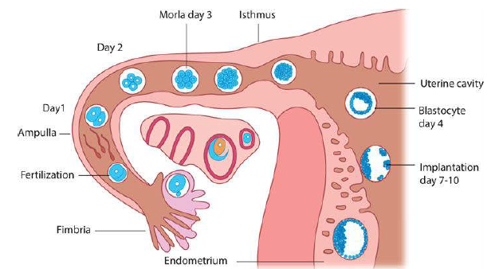
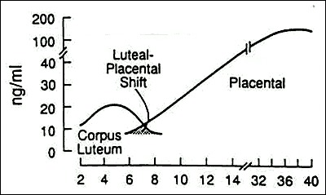
What we know
Fertilisation happens in the tube
Embryo is transported to the uterus
Implantation around D6-7
Progesterone required to support the pregnancy
Progesterone mainly from the corpus luteum
CL maintained by the hCG from the blastocyst
Placenta secrete adequate amounts of Prog. after
9 weeks

Slide 3
Miscarriage
A pregnancy that ends before 24 weeks of gestation
A common occurrence (10-20%)
Many women would suffer through one or more during their lifetime
Very distressing situation for the woman due to the loss

Slide 4
Miscarriage
Common presentation is vaginal bleeding
Some may be an incidental finding in routine ultrasound
Types of miscarriage described according to the presentation and findings

Slide 5
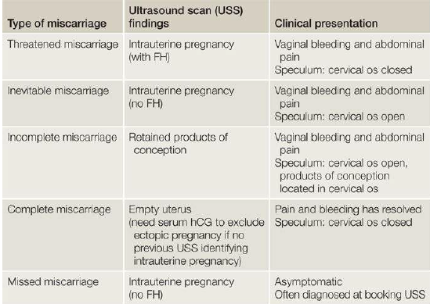
Types of miscarriage

Slide 6
Types of miscarriage
Threatened MC
Normal pregnancy
Inevitable MC
Missed MC
Incomplete MC
Complete MC

Slide 7
Why miscarriage happen?
Chromosomal abnormalities(commonest)
Medical/ endocrine disorders
Uterine abnormalities
Infections
Drugs/ chemicals

Slide 8
How to manage a patient with miscarriage?
Assessment
Establish the location and the gestation of the pregnancy
Assess the blood loss and pain
Blood group and Rhesus state

Slide 9
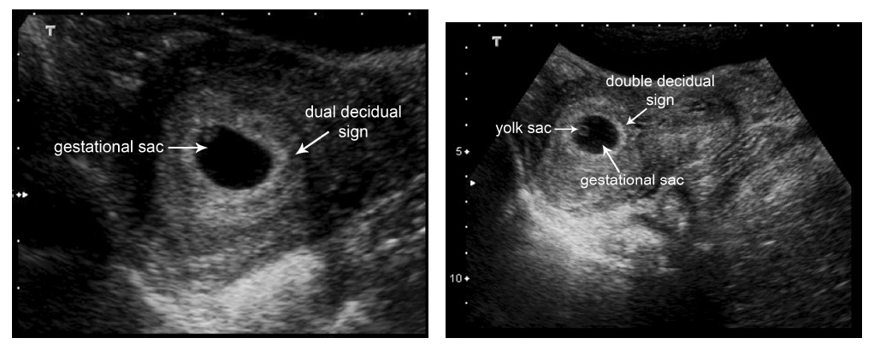
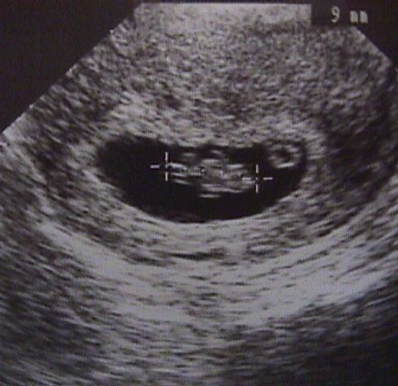
Establish the location of the pregnancy
What we know
A TVS can show a IUGS at around 5 weeks gestation
5 wks. GS seen
5+ wks. GS seen
6+ wks. FHB can be seen

Slide 10
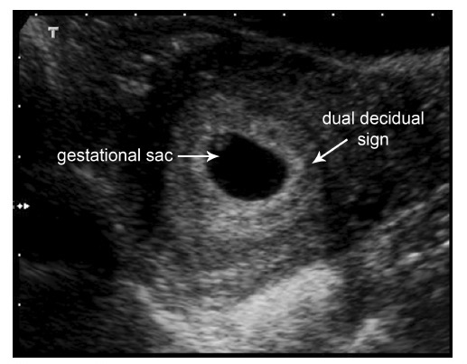
Establish the location of the pregnancy
What we know
A TVS can show a IUGS at around 5 weeks gestation
The serum hCG would be >1500 IU/L
This is called the discriminatory level
5 wks. GS seen

Slide 11
Establish the location of the pregnancy
What if we don’t see a pregnancy?
A pregnancy of ‘unknown location’ (PUL)
hCG < 1500 | hCG > 1500
DD Early IUP Ongoing Failing Ectopic pregnancy | DD Ectopic pregnancy Failing IUP Early multiple pregnancy

Slide 12
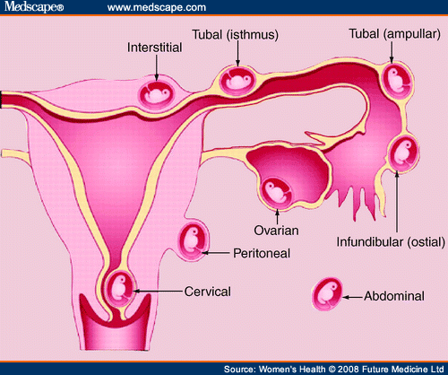
Ectopic pregnancy
Ectopic pregnancy
Implantation of a pregnancy outside the normal uterine cavity
>98% implanted within the fallopian tubes
Other rare sites
Interstitium of the tube, ovary, cervix,
abdominal cavity

Slide 13
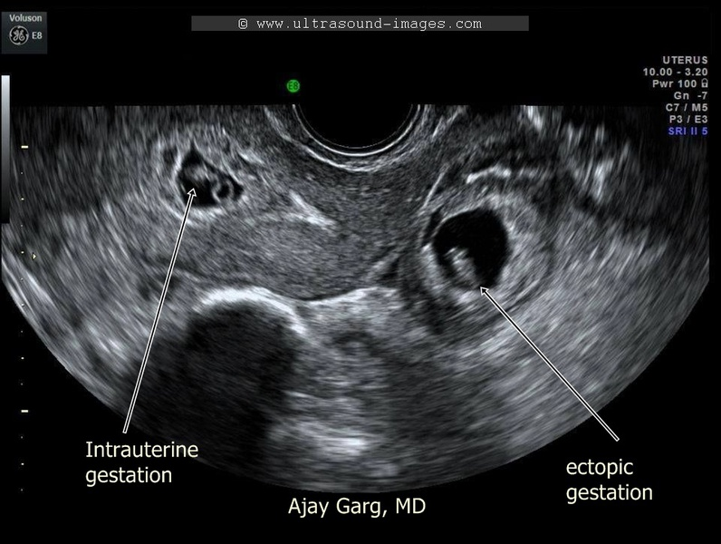
Ectopic pregnancy
Heterotrophic pregnancy
Pregnancies within and outside the cavity simultaneously
Rare < 1:15000

Slide 14
Why do ectopic pregnancies occur?
Abnormal fallopian tube
Unable to transport the embryo
Damage to the tube
Infection, tubal surgery, previous ectopic pregnancy
Impair the function of the tube
Pelvic disease (endometriosis, PID), adhesions due to surgery, IUCD use, pregnancy during progesterone use

Slide 15
How does ectopic pregnancies present?
Mostly of abdominal pain/ vaginal bleeding in early pregnancy
Sometimes with acute presentation after rupture of a tube and haemoperitonium
Haemodynamically compromised
Acute abdomen
Diaphragmatic irritation
Shoulder tip pain

Slide 16
How to diagnose an ectopic pregnancy?
TVS assessment
Seeing an IUP exclude (except in heterotrophic pregnancy)
An empty uterus with an adnexal mass
Look for size, FHB
Free fluid is suggestive of ruptured ectopic
Serum hCG rise
In normal IUP hCG nearly doubles every 48 hours (>66% rise)
In ectopic preg. the rise is less
A failing hCG means a failing pregnancy

Slide 17
Management of miscarriage
Expectant management
Medical management
Surgical management

Slide 18
Management of miscarriage
Expectant management
Await up to 2 weeks
Review in 2 weeks
Bleeding happened - is the uterus empty
If no bleeding – is the pregnancy still intact
Good | Bad
Don’t need hospital stay Avoid surgery Feels more closer to nature | Unscheduled Take longer Will experience pain and bleeding May need emergency surgery

Slide 19
Management of miscarriage
Medical management
Administration of Misoprostol
Review after bleeding
Has it completely expelled
Vaginally or orally
In missed miscarriage, mifepristone is added to promote cervical ripening and placenta seperation
Good | Bad
Don’t need hospital stay Avoid surgery Can schedule the event Can shorten the waiting time | Will experience pain and bleeding May need emergency surgery (10%)

Slide 20
Management of miscarriage
Surgical management
Under general anaesthesia
Cervical dilatation and evacuation of products of conception
Suction evacuation
Evacuation of retained products of conception
Good | Bad
Highest success rate (95%) Can schedule the event Can shorten the waiting time No pain/ bleeding | Risk of surgery and anaesthesia Uterine perforation, Cx damage Use of theatre time

Slide 21
Management of PUL
Make sure the woman is haemodynamically stable
If ectopic is likely (hCG > 1500), inward care
Repeat the hCG in 48 hours
>66% rise – likely IUP. Rescan when hCG > 1500
>15% drop – failing pregnancy. Review with uPT in one week
In-between – likely ectopic pregnancy. Manage accordingly

Slide 22
Management of Ectopic Pregnancy
Expectant management
Medical management
Surgical management

Slide 23
Management of Ectopic Pregnancy
Expectant management
Majority of EP’s will fail(Majority of ectopic pregnancies will resolve through regression or a tubal abortion without any treatment)
Monitor hCG till it is undetectable
Suitable for
Asymptomatic – no bleeding
Haemodynamically stable
Early gestations (hCG < 1000)

Slide 24
Management of Ectopic Pregnancy
Medical management using IM Methotrexate
FA antagonist inhibiting DNA synthesis
Affect division of trophoblastic cells
Administer Methotrexate and monitor hCG levels (D0, 4, 7)
Expect a drop between D4-D7
If no adequate drop, may consider a repeat dose
Avoid surgery

Slide 25
Management of Ectopic Pregnancy
Medical management using IM Methotrexate
Suitable for early gestations
Size <3cm
No FHB
hCG < 3000 IU/L
Need to avoid pregnancy for 3 months

Slide 26
Contraindications to the use of methotrexate
Liver disease
Renal disease
Haematological disorder
Active infection
Immunodeficiency
Breastfeeding
Follow up with serum beta hCG level
What are the other instances where methotrexate is used?

Slide 27
Management of Ectopic Pregnancy
Surgical management
When haemodynamically not stable
Viable ectopic pregnancy (FHB scan)
High hCG levels (>3000 IU/L)
Patient preference

Slide 28
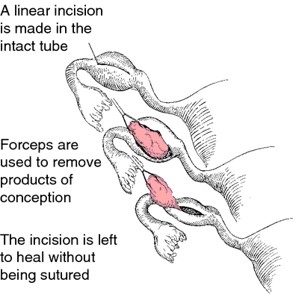
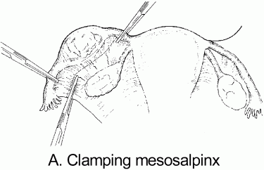
Management of Ectopic Pregnancy
Surgical management
Laparoscopy or laparotomy
Salpingostomy or salpingectomy

Slide 29
Management of Ectopic Pregnancy
In future pregnancies,
The fertility may not be affected if the other tube is normal
Higher risk of repeat ectopics (1:5 cf 1:80)
Even after salpingectomy
Need to have a scan to locate pregnancy early

Slide 30
Gestational trophoblastic disease
A spectrum of interrelated but histological distinct tumors arising from the placenta
WHO classification
Molar pregnancies
Hydatidiform mole – Complete, partial
Invasive mole
Trophoblastic disease
Choriocarcinoma
Placental site trophoblastic tumors
Epithelioid trophoblastic tumor

Slide 31
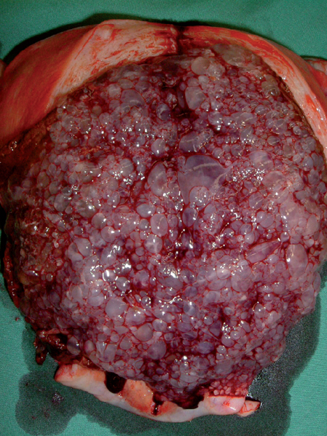
Gestational trophoblastic neoplasia

Slide 32
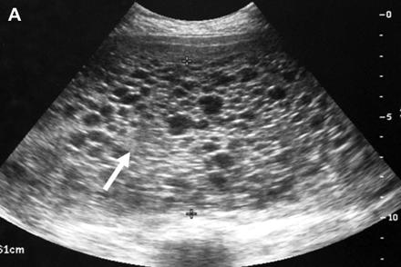
Gestational trophoblastic neoplasia

Slide 33
Clinical features
Irregular vaginal bleeding
Hyperemesis
Excessive uterine enlargement
Early failed pregnancy

Slide 34
Rare clinical features
Hyperthyroidism
Early onset pre-eclampsia
Abdominal distension due to theca lutein cysts
Acute respiratory failure
Seizures

Slide 35
Treatment
Suction curettage

Slide 36
Treatment
Medical evacuation of complete molar pregnancies should be avoided if possible. There is theoretical concern over the routine use of potent oxytocic agents because of the potential to embolise and disseminate trophoblastic tissue through the venous system.

Slide 37
Anti D in GTN
Because of poor vascularisation of the chorionic villi and absence of the anti-D antigen in complete moles, anti-D prophylaxis is not required.
It is, however, required for partial moles.

Slide 38
Follow up
Follow up after GTD is increasingly individualised.
If hCG has reverted to normal within 56 days of the pregnancy event then follow up will be for 6 months from the date of uterine evacuation.
If hCG has not reverted to normal within 56 days of the pregnancy event then follow-up will be for 6 months from normalisation of the hCG level.

Slide 39
Contraception
Women with GTD should be advised to use barrier methods of contraception.
Women should be advised not to conceive until their follow-up is complete.
Women who undergo chemotherapy are advised not to conceive for 1 year after completion of treatment.

Slide 40
Women should be advised not to conceive until their follow-up is complete.
Women who undergo chemotherapy are advised not to conceive for 1 year after completion of treatment.

Slide 41
Hyperemesis gravidarum
Excesive vomiting during pregnancy
Dehydrated
Undernutrition
Marked weight loss
Muscle wasting
Ketonuria
Electrolyte disturbances
Ptyalism – inability to swallow saliva

Slide 42
Risks
Fetal growth restriction
Hyponatraemia – central pontine myelinolysis
Thiamine deficiency – Wernicke’s encephalopathy

Slide 43
Markers of severity
Weight loss > 10 %
Abnormal thyroid function tests
Raised free T4
Suppressed TSH
Raised liver transaminases

Slide 44
Management
Exclude other causes of nausea and vomiting
Take vomiting in late pregnancy very seriously
Investigations
FBC, BU, SE, LFT, TFT
UFR, urine culture and ABST
USS of the uterus to exclude multiple pregnancy and hydatidiform mole

Slide 45
Management contd…….
Ensure adequate hydration
Normal saline
Hartmann
Avoid too much of dextrose containing fluids – may precipitate Wernicke’s encephalopathy
(Wernicke’s encephalopathy is prevented by adding routine adminjstration of oral or intravenous thiamine)

Slide 46
Management contd……..
Cyclizine
Promethazine
Metoclopramide
Domperidone
Ondansetron
Add an antacid, H2 receptor blocker or a proton pump inhibitor
Corticosteroids in refractory cases

